Slide 1
Chapter-3 MICROPROCESSOR

Slide 2
PART – A

Slide 3
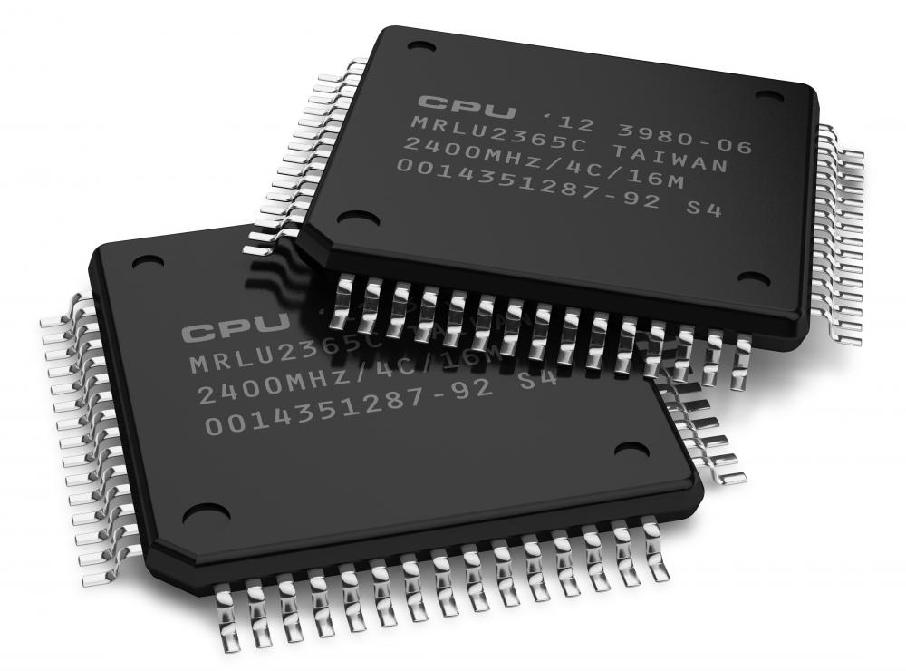
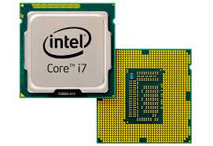
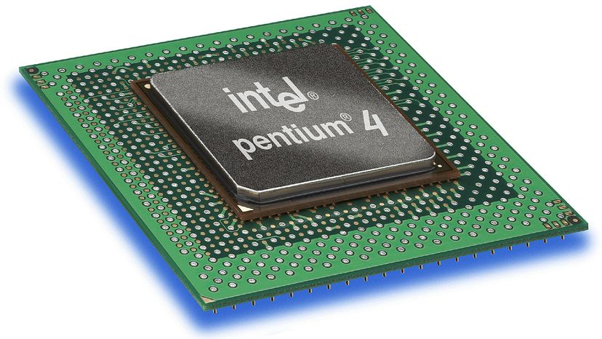
MICROPROCESSOR
Microprocessor is an electronic circuit that contains the arithmetic, logic, and control circuitry necessary to perform the functions of a digital computer's central processing unit (CPU).

Slide 4
FUNCTIONS OF MICROPROCESSOR
Among various functions of microprocessor some are as follows
Controlling all other parts of the machine and sending timing signals.
Transferring data between memory and I/O devices
Fetching data and instructions from memory
Decoding instruction
Performing arithmetical and logical operations
Executing programs stored in memory
Performing communication among the I/O devices etc.

Slide 5
MICROPROCESSOR ARCHITECTURE
The microprocessor is a single IC package in which several useful functions are integrated and fabricated on a single silicon semiconductor chip.
Its architecture consists of a central processing unit, memory modules, a system bus, and an input/output unit.
The system bus connects the various units to facilitate the exchange of information. It further consists of data, address, and control buses to perform data exchanging properly.

Slide 6
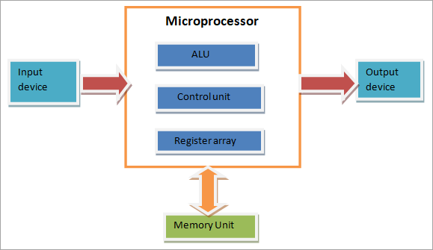
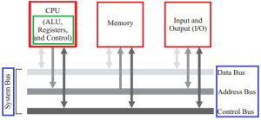
MICROPROCESSOR ARCHITECTURE

Slide 7
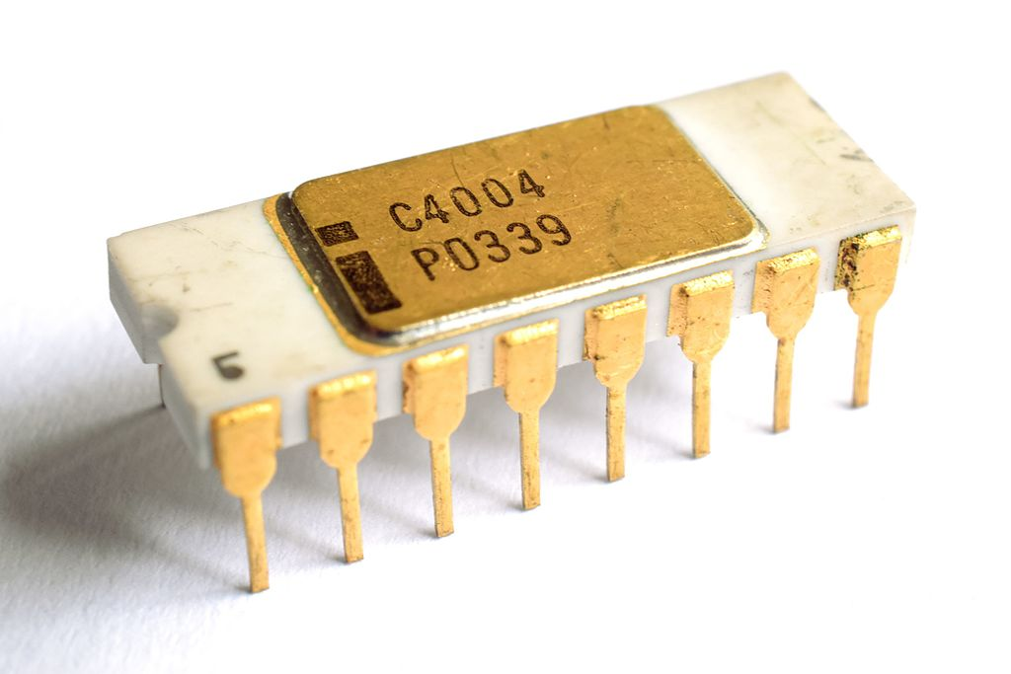
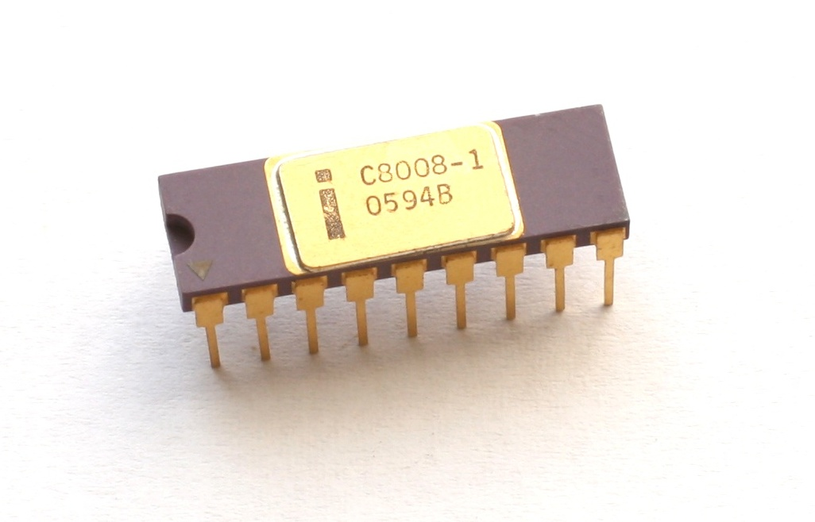
EVOLUTION OF MICROPROCESSOR
First Generation Microprocessor (1971 – 73)
Intel 4004
The first microprocessor by Intel.
Introduced in 1971
4 KB main memory
It was 4-bit, PMOS Technology
Intel 8008
Introduced in 1972
It was 8 -bit.
16 KB main memory
PMOS Technology

Slide 8
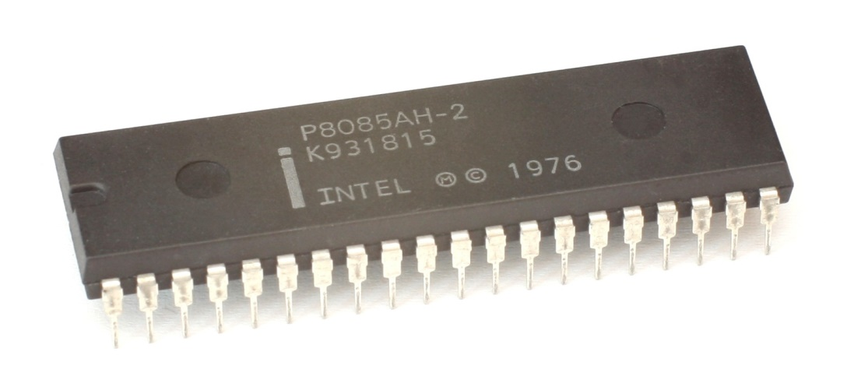
EVOLUTION OF MICROPROCESSOR
Second Generation Microprocessor (1974- 78)
Intel 8085
Introduced in 1975
It was 8 -bit.
64KB main memory
Intel sold 100 million copies of this processor.

Slide 9
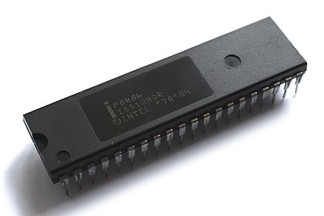
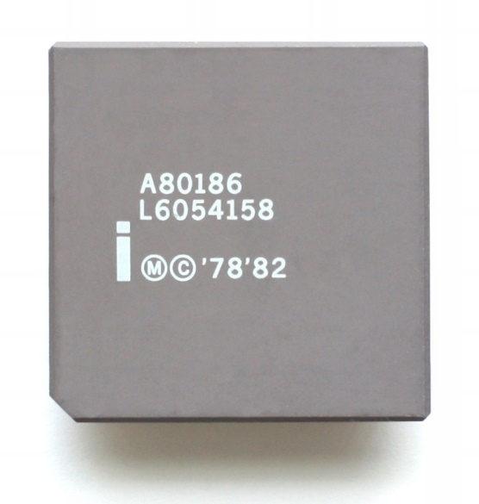
EVOLUTION OF MICROPROCESSOR
Third Generation Microprocessor (1979-80)
Intel. 8086
Introduced in 1978
16-bit
HMOS technology
1 MB of memory.]
Intel. 80186
Introduced in 1982
Upgraded version of Intel. 8086
16-bit
HMOS technology
1 MB of memory.]

Slide 10
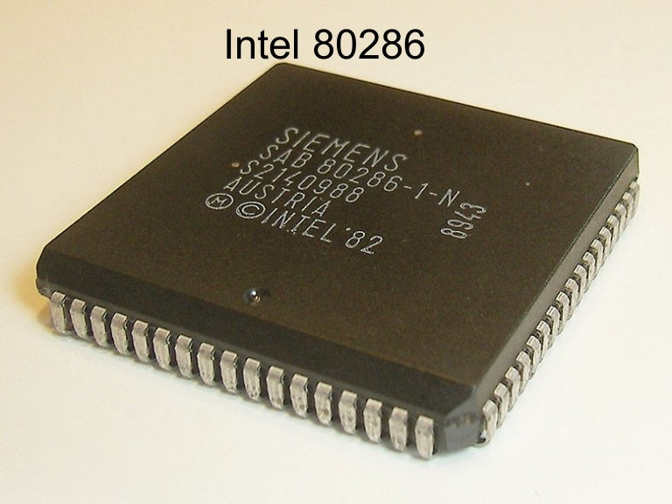
Third Generation Microprocessor (1979-83)
Intel. 80286
Introduced in 1983
16-bit high performance microprocessor with memory management & protection.
Instruction execution time is as little as 250 ns.
HMOS technology
16 MB of memory.]

Slide 11
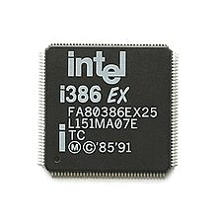
EVOLUTION OF MICROPROCESSOR
Fourth Generation 32-bit Microprocessor
Intel. 80386
Introduced in 1986
Intel’s first practical 32-bit microprocessor
4 GB main memory
Improvements include page handling in virtual environment

Slide 12
EVOLUTION OF MICROPROCESSOR
Fifth Generation Microprocessor (1995 – till date)
This age the emphasis is on introducing chips that carry on-chip functionalities and
improvements in the speed of memory and I/O devices along with introduction of 64-bitmicroprocessors.
Intel leads the show here with Pentium, Celeron and very recently dual and quad core processors working with up to 3.5GHz speed.

Slide 13
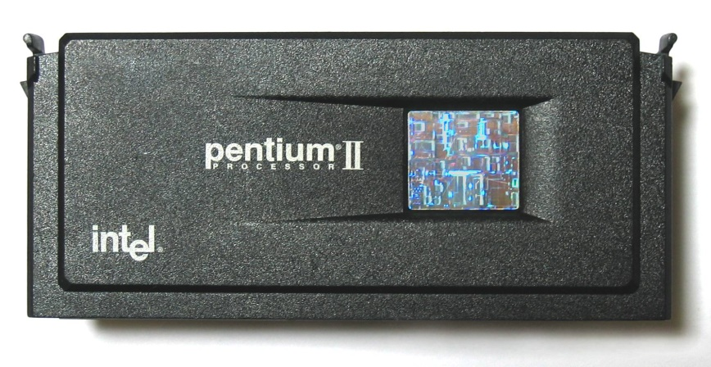
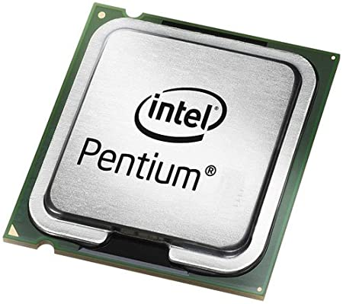
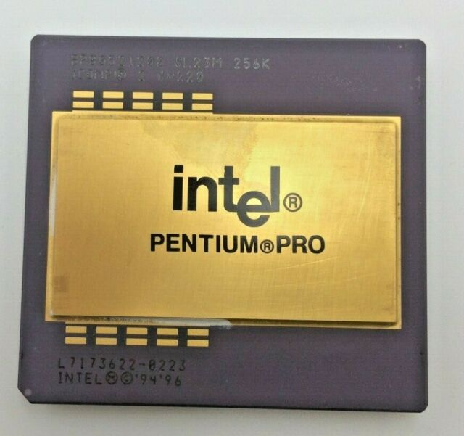
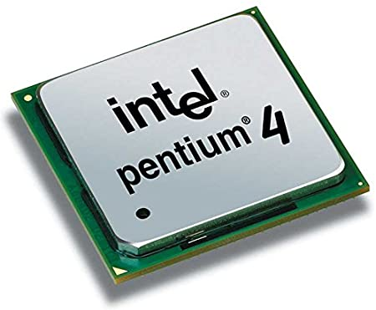
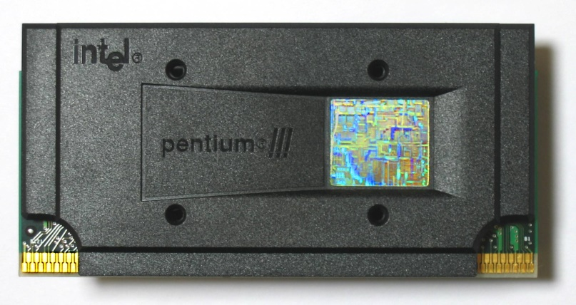
EVOLUTION OF MICROPROCESSOR
Fifth Generation Microprocessor (1995 – till date)

Slide 14
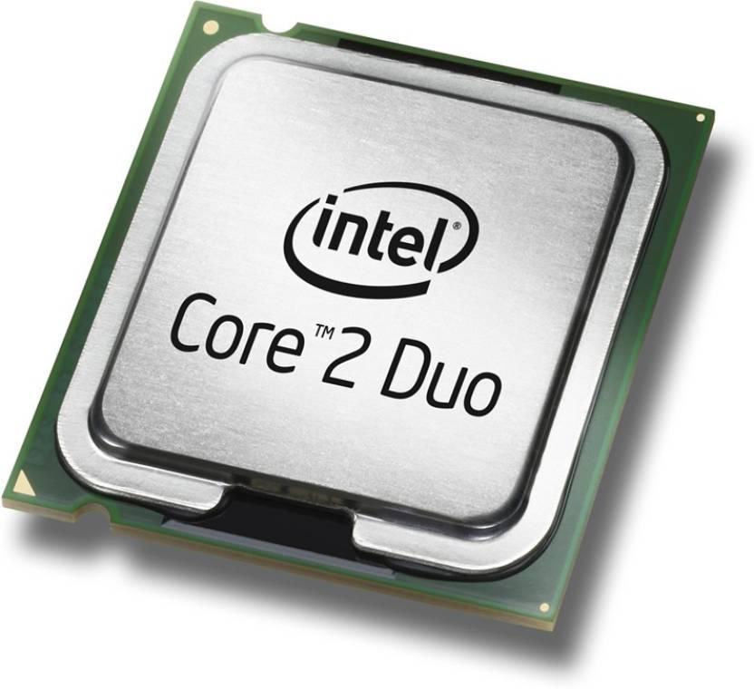
EVOLUTION OF MICROPROCESSOR
Fifth Generation Microprocessor (1995 – till date)
Intel core 2
The Core 2 brand was introduced on 27 July 2006
Core 2 having a range of Intel's consumer 64-bit x86-64 single-, dual-, and quad-core microprocessors based on the Core microarchitecture

Slide 15
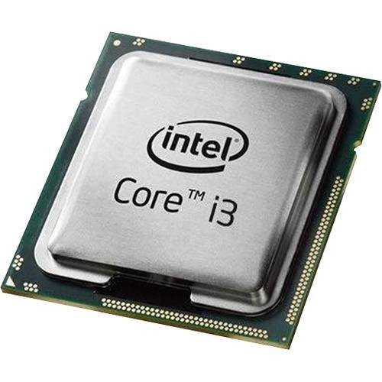
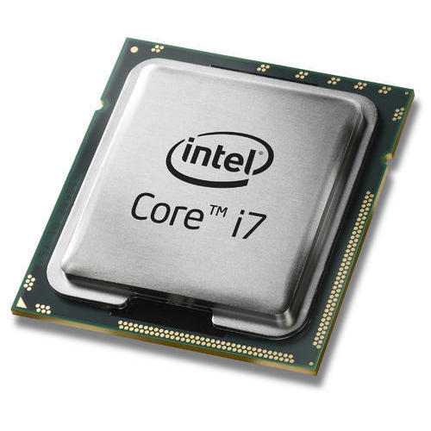
EVOLUTION OF MICROPROCESSOR
Fifth Generation Microprocessor (1995 – till date)
Core i series
The Core i3 range is entirely dual-core.
The i7 range are all quad-core.
Core i3 processors don't have Turbo Boost
The Core i7-6700, for example, has a base clock of 3.4GHz, but can 'boost' up to 4GHz.

Slide 16
THE INTEL FAMILY MICROPROCESSOR
Microprocessor | Year of Invention | Length | Clock | Remarks
4004 | 1971 | 4-bit | 750 KHz | First Microprocessor
8085 | 1976 | 8-bit | 3-6 MHz | Popular 8-bit Microprocessor
8086 | 1978 | 16-bit | 5-8 MHz | Widely used in PC/X
80286 | 1982 | 16-bit | 6-12.5 MHz | Widely used in PC/AT
80386 | 1985 | 32-bit | 20-33 MHz | Contains MMU on chip
80486 | 1989 | 32-bit | 25-100 MHz | Contains MMU, cache and FPU, 1.2 million transistors

Slide 17
THE INTEL FAMILY MICROPROCESSOR
Microprocessor | Year of Invention | Length | Clock | Remarks
Pentium | 1993 | 32-bit | 60-200 | Contains 2 ALUs,2 Caches, FPU, 3.3 Million transistors, 3.3 V, 7.5 million transistors
Pentium Pro | 1995 | 32-bit | 150-200 MHz | It is a data flow processor. It contains second level cache also,3.3 V
Pentium II | 1997 | 32-bit | 233-400 MHz | All features Pentium pro plus MMX technology,3.3 V, 7.5 million transistors
Pentium III | 1999 | 32-bit | 600-1.3 MHz | Improved version of Pentium II; 70 new SIMD instructions
Pentium 4 | 2000 | 32-bit | 600-1.3 GHz | Improved version of Pentium III
Itanium | 2001 | 64-bit | 733 MHz-1.3 GHz | 64-bit EPIC Processor

Slide 18
QUICK BRAIN – Sample Question 1
What is a microprocessor?
How does it work?
which was the first microprocessor?

Slide 19
PART – B

Slide 20
FEATURES OF MICROPROCESSOR
Portability
Low Cost
Versatile
Small in size
Low power consumption
Reliability

Slide 21
TYPES OF MICROPROCESSOR
Type of Architecture | Features | Usage
CISC (Complex Instruction Set Computer) | Large instruction set Variable-length instructions Variety of addressing modes Complex & expensive to produce | Mostly used in personal computers
RISC (Reduced Instruction Set Computer) | Small instruction set Fixed-length instructions Reduced references to memory to retrieve operands | Mostly used in workstations

Slide 22
TYPES OF MICROPROCESSOR
Type of Architecture | Features | Usage
EPIC (Explicitly Parallel Instruction Computing) | Allows software to communicate explicitly to the processor when operations are parallel Uses tighter coupling between the compiler and the processor Enables compiler to extract maximum parallelism in the original code, and explicitly describe it to the processor | Mostly used in high-end servers and workstations

Slide 23
TYPES OF MICROPROCESSOR
Type of Architecture | Features | Usage
Multi-Core Processor | Processor chip has multiple cooler-running, more energy- efficient processing cores Improve overall performance by handling more work in parallel can share architectural components, such as memory elements and memory management | Mostly used in high-end servers and workstations

Slide 24
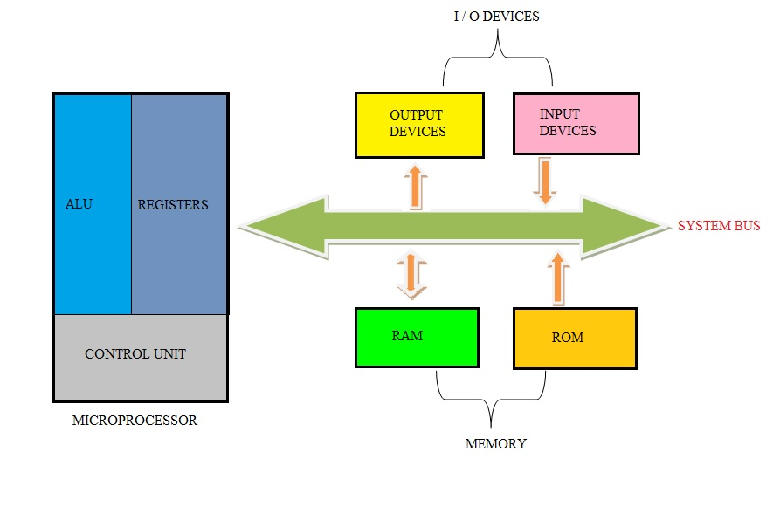
MICROPROCESSOR BLOCK DIAGRAM

Slide 25
NECESSARY COMPONENTS FOR MICROPROCESSOR
CPU: Central Processing Unit
I/O: Input/Output
System Bus: Address bus, Data Bus
CU: Timing & Control Unit
Registers
L1 & L2 Cache Memory

Slide 26
TIMING & CONTROL UNIT
CPU is partitioned into ALU & CU
Control Unit
The Function of control unit is to generate the relevant timing & control signals to all operations of the in the computer.
It controls the flow of data between the processor & memory & peripherals.

Slide 27
ARITHMETIC LOGIC UNIT (ALU)
ALU Performs arithmetic and logical operations
It includes storage places for input operands that are being added, the accumulated results (stored in an accumulator) and shifted results.
Performs arithmetic operations (+, -, ×, ÷)
Also Performs logical operations (AND, OR, NOT , XOR)

Slide 28
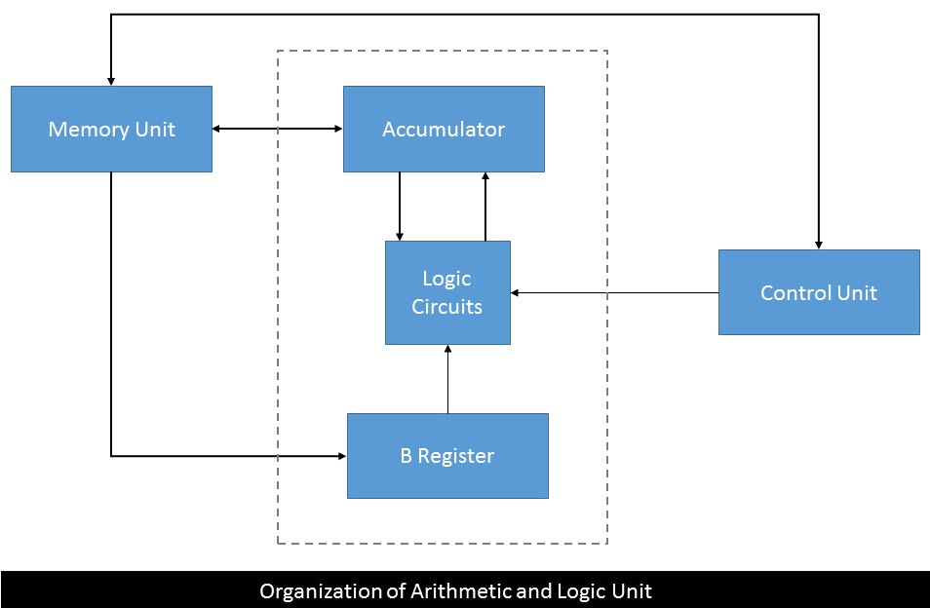
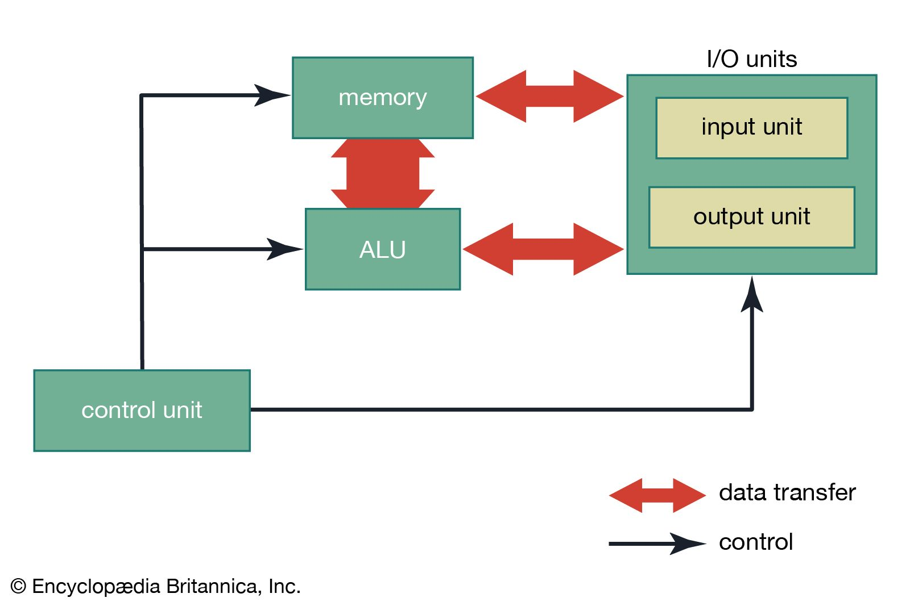
HOW ALU WORKS?
For more details: https://www.youtube.com/watch?v=UsK5KV1FPmA&t=39s

Slide 29
QUICK BRAIN – Sample Question 2
State 3 differences between CISC, RISC
How does ALU work?
Why is microprocessor called versatile?

Slide 30
PART – C

Slide 31
L1 & L2 CACHE MEMORY
L1 & L2 are levels of cache memory in a computer.
L1 is "level-1" cache memory, usually built onto the microprocessor chip itself.
L2 (that is, level-2) cache memory is on a separate chip (possibly on an expansion card) that can be accessed more quickly than the larger "main" memory

Slide 32
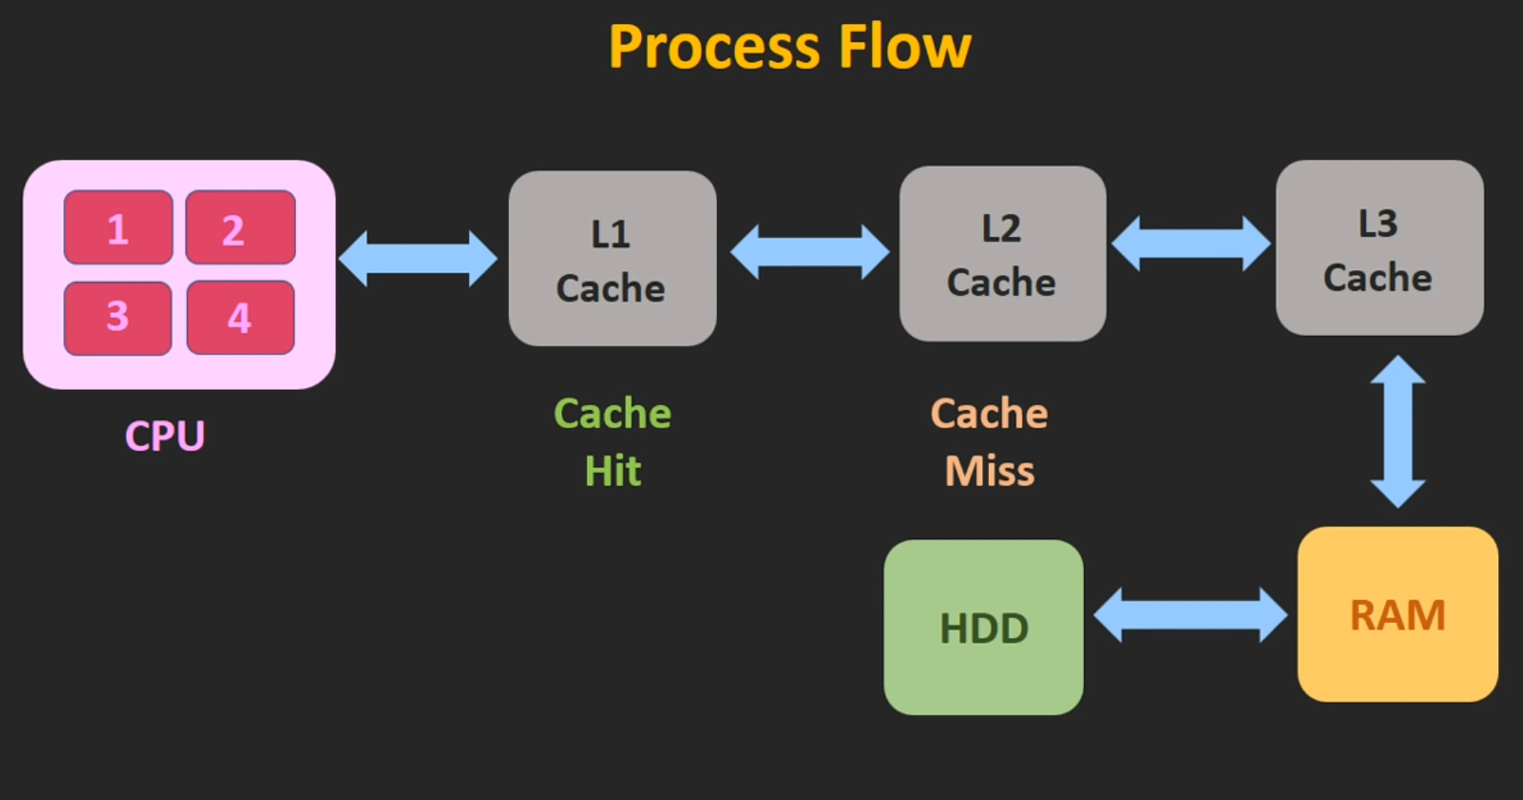
L1 & L2 CACHE MEMORY

Slide 33
SPECIAL & GENERAL PURPOSE REGISTER
General purpose register can be used as either data or address register.
There are 6 general purpose registers namely B, C, D, E, H, L.
Each of them is a 8- bit registers.
They are used to hold data and results.
To hold 16-bit data, combinations of two 8-bit registers can be used.

Slide 34
BUS INTERFACE
The bus interface unit is the part of a processor that interface with the rest of the PC.
It deals with moving information over the processor data bus, the primary conduit for the transfer of information to & from the CPU.
Responsible for responding to all signals that go to the processor & generating all signals that go from the processor to other parts of the system.

Slide 35
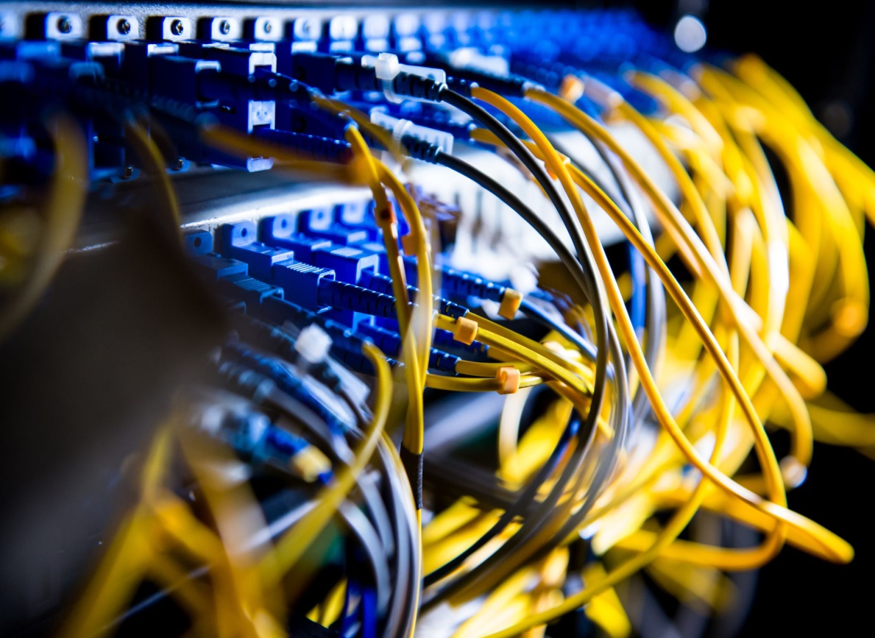
DATA BUS
A collection of wires in which data is transmitted from one computer to another external drive.
It carries digital information.
It is connected to the inputs of several fates and to the outputs of several gates.
This is also called bi-directional bus as information may flow on the bus wires in both directions.

Slide 36
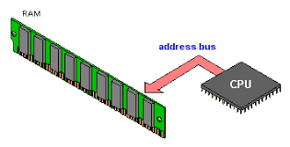
ADDRESS BUS
An address bus is a computer bus that is used to specify a physical address.
The width of the address bus determines the amount of memory a system can address.
It transfers the address of the location.
It is called uni-directional as it transfers the address from CPU to memory only.

Slide 37
REGISTER
Special memory units, called registers, are used to hold information on a temporary basis as the instructions are interpreted and executed by the CPU
Registers are part of the CPU (not main memory) of a computer
The length of a register, sometimes called its word size, equals the number of bits it can store
With all other parameters being the same, a CPU with 32-bit registers can process data twice larger than one with 16-bit registers

Slide 38
REGISTER CLASSIFICATION
Sr. No. | Name of Register | Function
1 | Memory Address (MAR) | Holds address location | of | the | active | memory
2 | Memory Buffer (MBR) | Holds contents of the (read/written) memory word |  |  |  | accessed
3 | Program Control (PC) | Holds address of the next instruction to be executed
4 | Accumulator (A) | Holds data to be operated upon, intermediate results, and the results
5 | Instruction (IR) | Holds an instruction while it is being executed
6 | Input/Output (I/O) | Used to communicate with devices |  |  |  | the | I/O

Slide 39
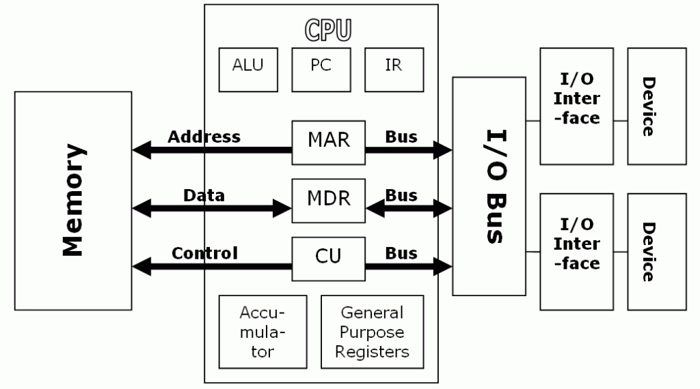
REGISTER
How Register works?
https://www.youtube.com/watch?v=Z5JC9Ve1sfI&t=171s

Slide 40
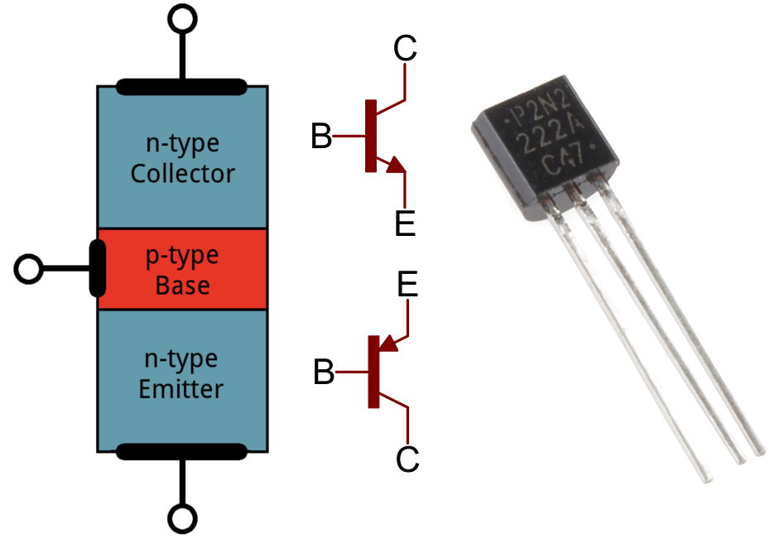
TRANSISTOR
Transistors are a three terminal semiconductor device used to regulate current, or to amplify an input signal into a greater output signal. Transistors are also used to switch electronic signals.

Slide 41
TRANSISTOR
The main functions of a transistor
A transistor is a semiconductor device used to amplify or switch electronic signals and electrical power. Transistors are one of the basic building blocks of modern electronics. It is composed of semiconductor material usually with at least three terminals for connection to an external circuit.
For details
https://www.youtube.com/watch?v=P3hf2EXhQzI&t=9s

Slide 42
QUICK BRAIN – Sample Question 3

